Slide 1
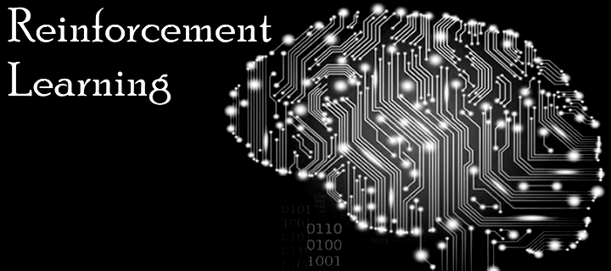
Introduction to Reinforcement Learning w/ some applications to Energy
LEC 1b: Motivation and History
Instructors: Professor Scott Moura & Saehong Park
TA: Xinyi Zhao
Summer 2020

Slide 2
Motivation
What problems does RL solve?

Slide 3
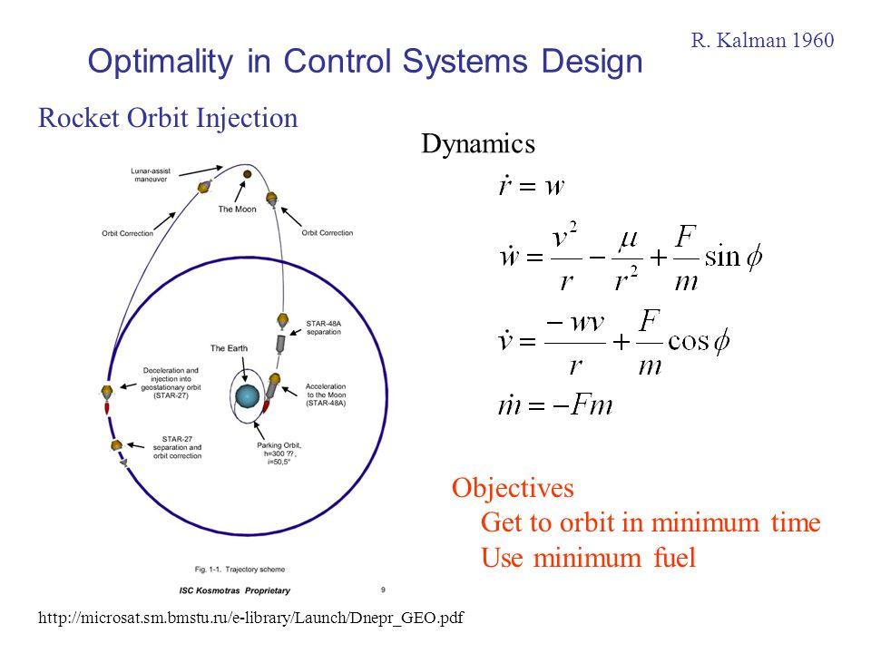
Example 1: Moonshot

Slide 4
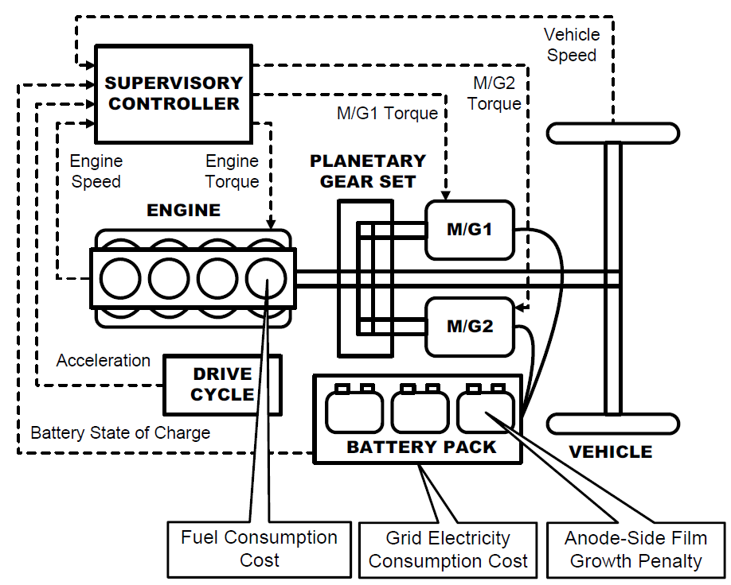
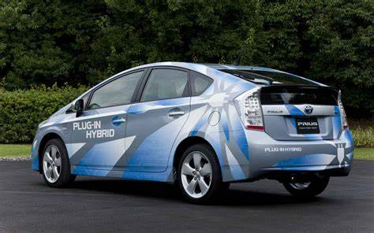
Example 2: Hybrid Vehicle Energy Management

Slide 5
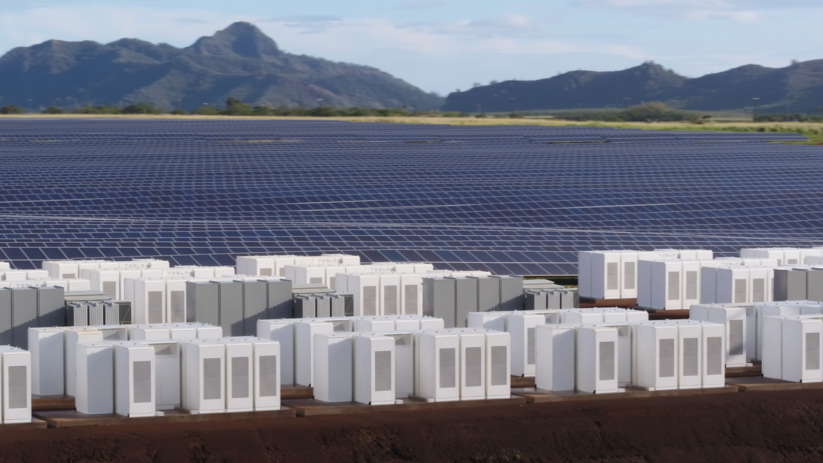
Example 3: Clean Energy

Slide 6

Example 4: My puppy Juno

Slide 7
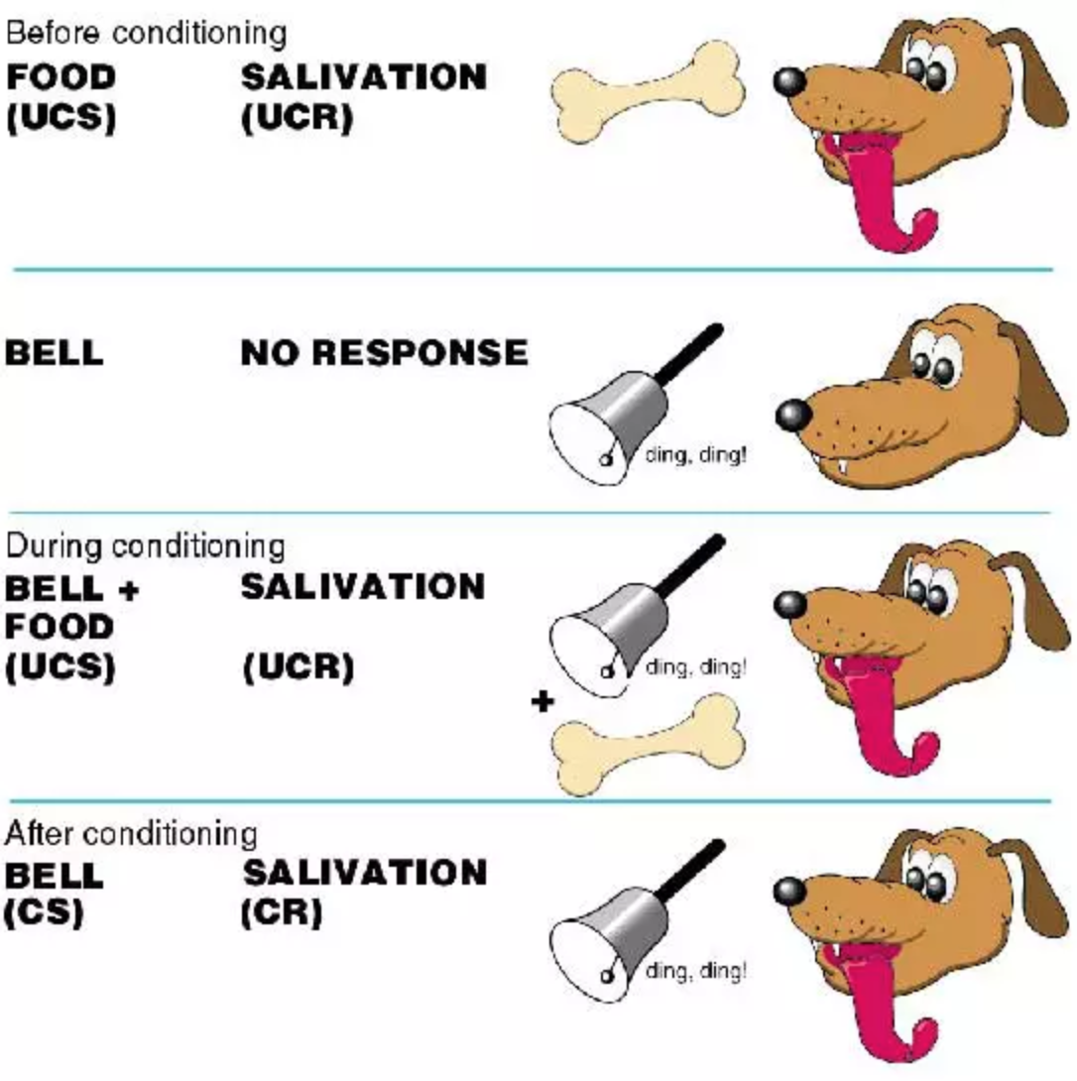
Short History – Ivan Pavlov (1890s)

Slide 8
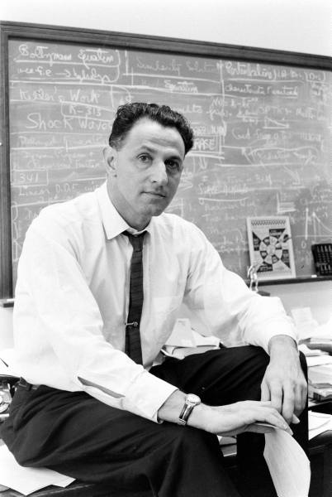

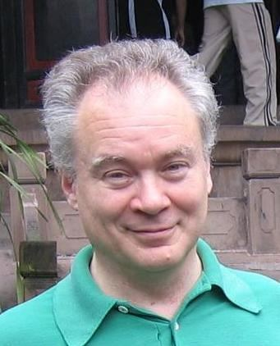
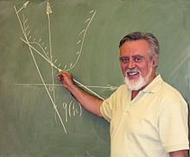
Short History – 20th Century
Richard Bellman – 1950s
Dynamic Programming
Markov Decision Processes
Optimal Control
Chris Watkins – 1989
Q-learning
Paul Werbos – 1970s-1990s
PhD Thesis: Backpropagation
”Heuristic Dynamic Programming”
Dimitri Bertsekas –
1990s-2000s
Dynamic Programming
Neuro-dynamic programming

Slide 9
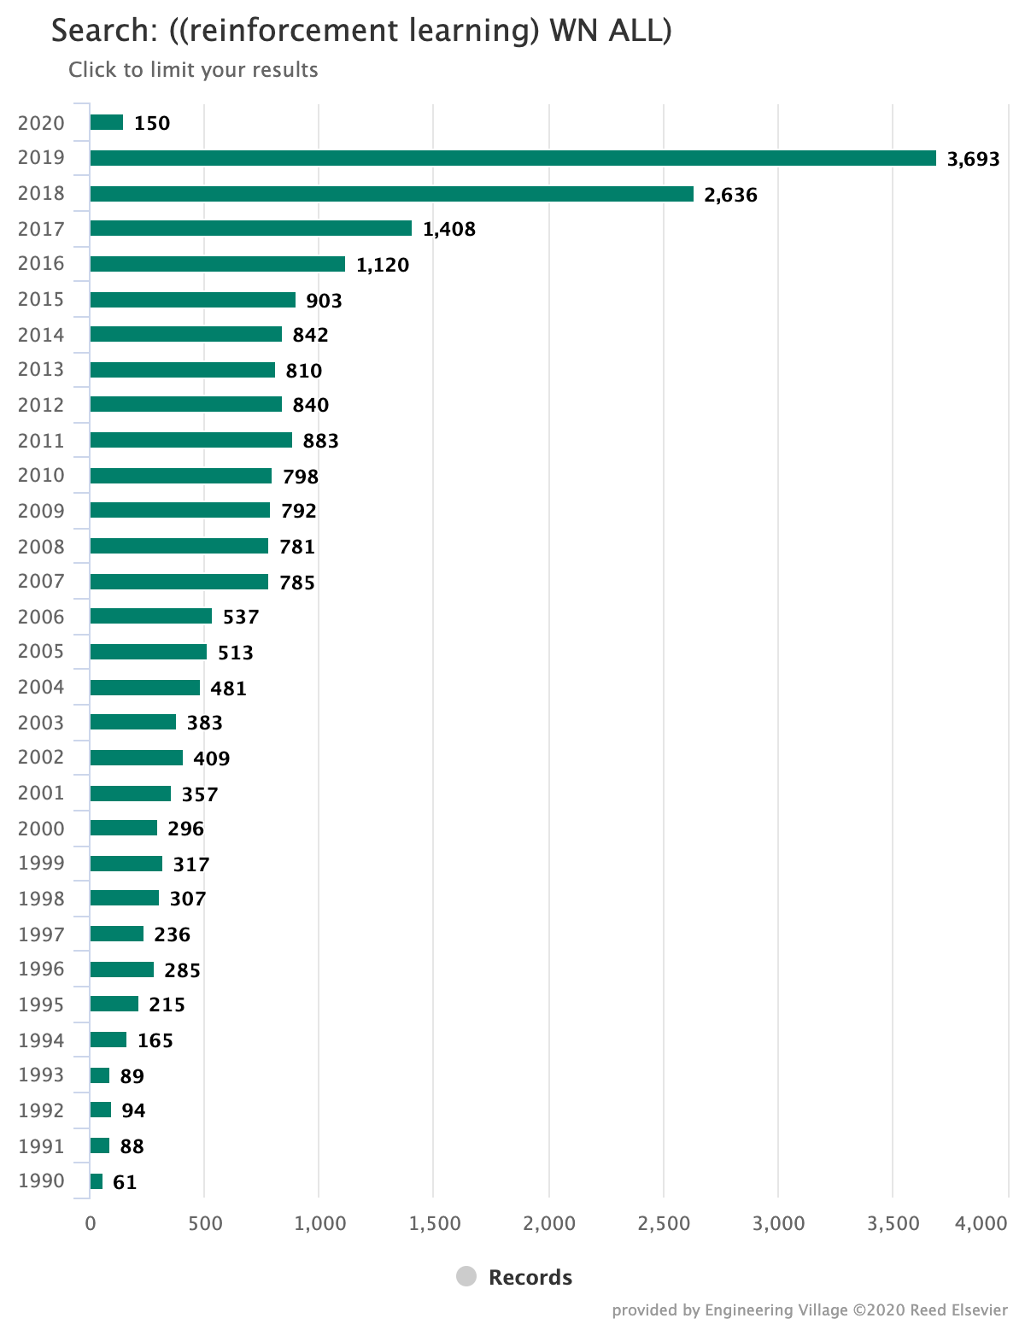
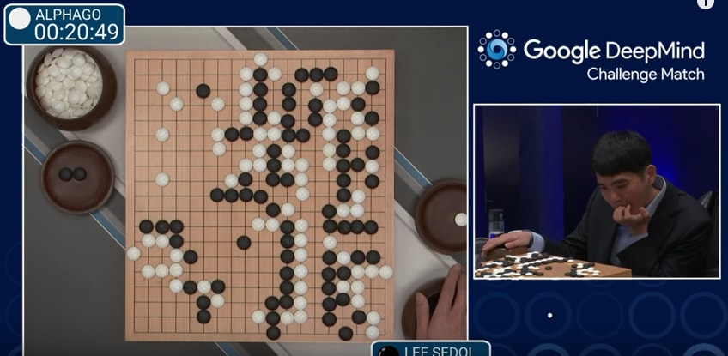
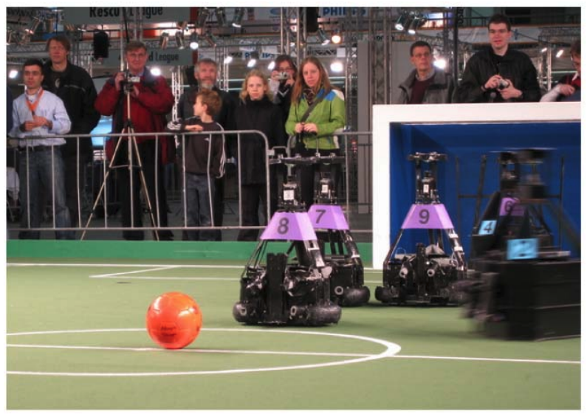
Recent History – 21st Century
Mnih et al ”Human-level control through deep reinforcement learning”, Nature, 2015
Reidmiller, Gabel, Hafner, Lange ”Reinforcement Learning for Robot Soccer”, 2009

Slide 10
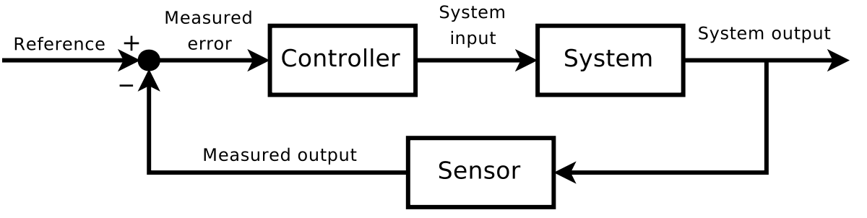
Problem Setup
Control Engineer view
Computer Science view

Slide 12
Key Characteristics of RL
Dynamic system
Reward/cost
Learning

